Slide 1
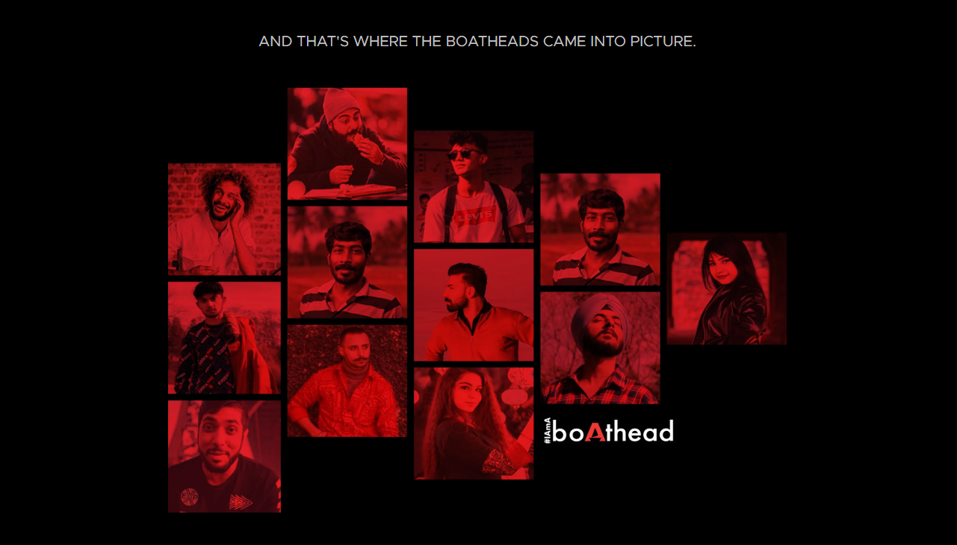


Slide 2

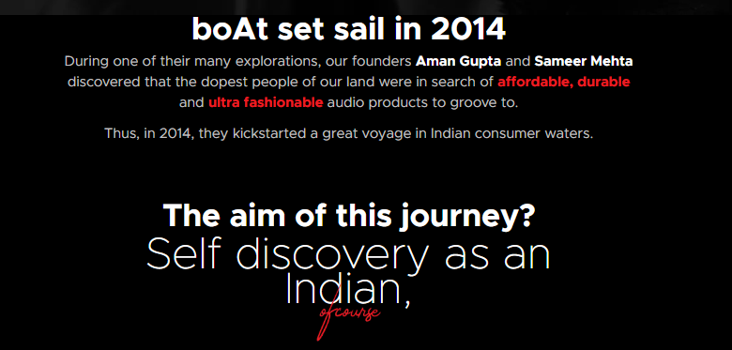
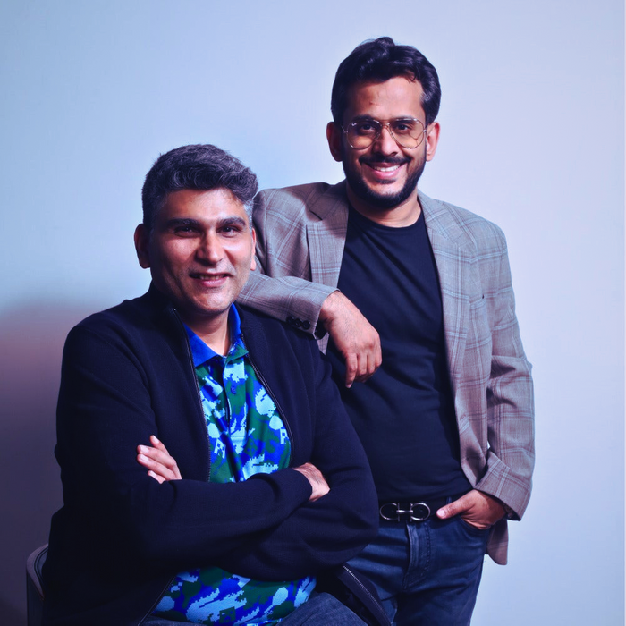
boAt India consumer electronics brand founded in 2016 by Aman Gupta and Sameer Mehta. Known for its stylish and affordable audio products like earphones, speakers, and smartwatches, boAt has quickly become a favorite among India’s youth. The brand blends technology with fashion, offering trendy, functional gadgets that reflect modern lifestyles. Its success is driven by influencer marketing, pop culture tie-ins, and a strong digital presence, making boAt a symbol of self-expression for the tech-savvy generation.
We chose boAt for this strategic marketing project because it represents a compelling case of a homegrown brand that has disrupted a highly competitive market. Its rapid rise, innovative marketing strategies, and strong brand identity make it ideal for applying and analyzing strategic frameworks in a real-world context.

Slide 3
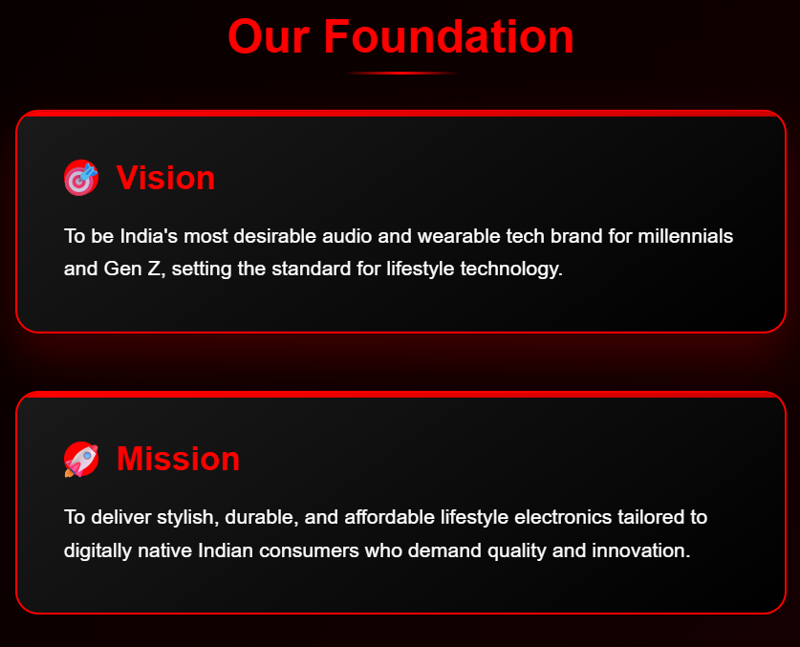
BRAND BACKGROUND
boAt has emerged as a dominant player in India’s D2C electronics space.
Known for affordable, stylish, and durable products like earphones, smartwatches, speakers, and grooming kits, boAt holds a 30% market share in the true wireless stereo (TWS) segment (Counterpoint Research, 2024).
Its digital-first strategy, celebrity endorsements, and youth-centric branding have fueled rapid growth.

Slide 4

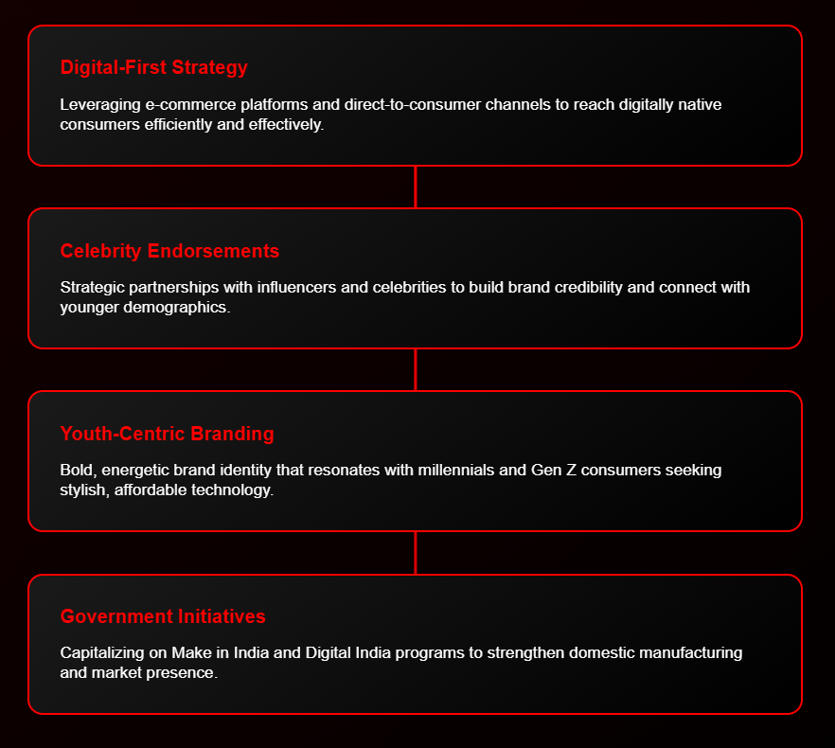

Slide 5
STRATEGIC CONNECTION ANALYSIS
Corporate Strategy
boAt aligns with national initiatives, such as Make in India, by manufacturing 70% of its products locally (boAt Corporate Website, 2025). Its focus on affordability, innovation, and aspirational branding resonates with India’s youth, driving brand loyalty.
Business Unit Strategy
● Innovation: Continuous product launches (e.g., boAt Airdopes with ANC, smartwatches with SpO2 monitoring).
● Digital Engagement: Leverages influencer marketing, social media, and D2C channels for personalized customer experiences.
● Pricing: Penetration pricing to capture market share while maintaining perceived premium quality.
Marketing Integration
● Digital Campaigns: Partners with influencers and celebrities (e.g., Hardik Pandya, Kiara Advani) for high-impact campaigns.
● Data-Driven Personalization: Uses analytics to tailor promotions and product recommendations.
Product Bundling: Offers combos (e.g., earphones + smartwatch) to increase average order value.

Slide 6
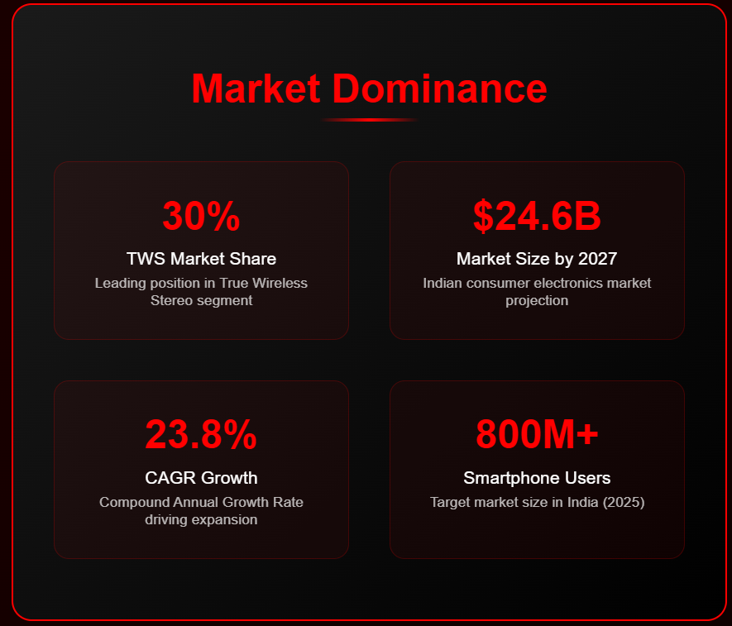
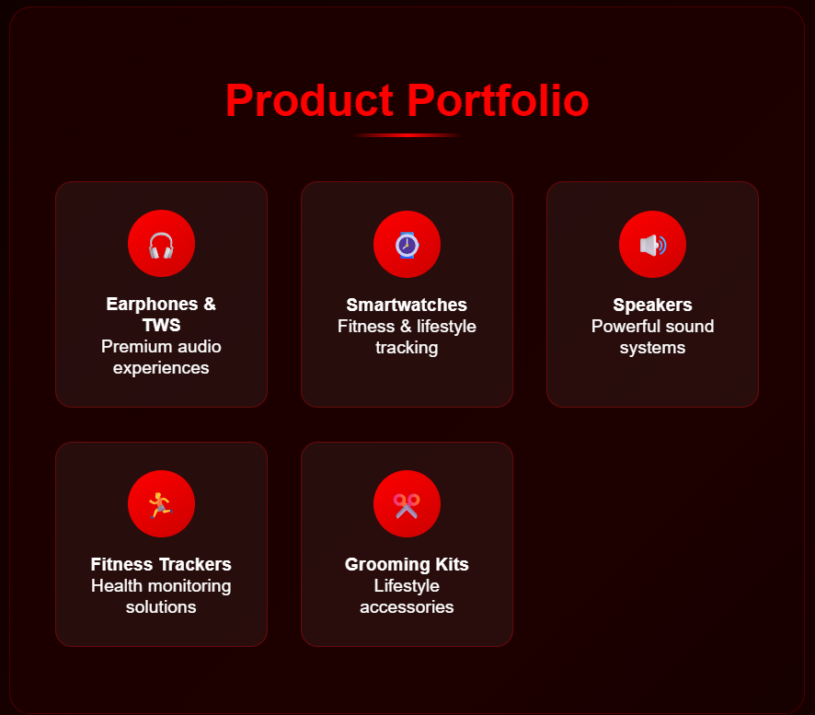

Slide 7
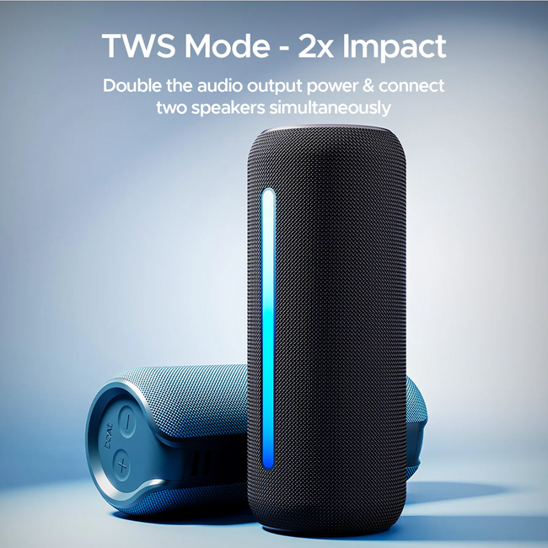
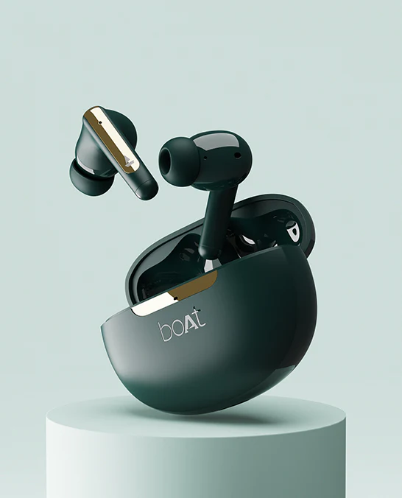
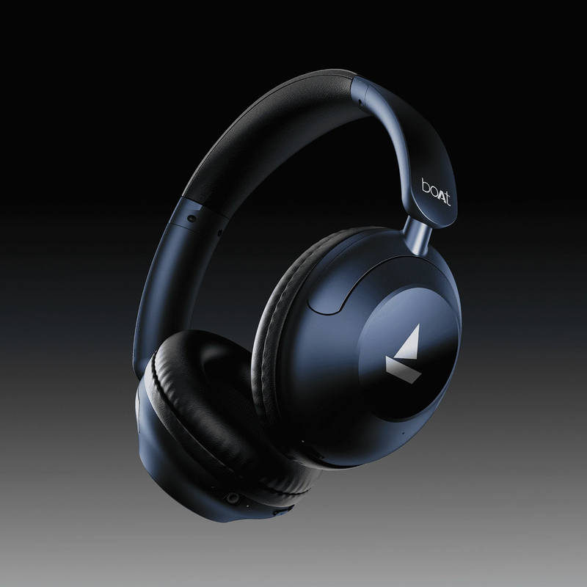
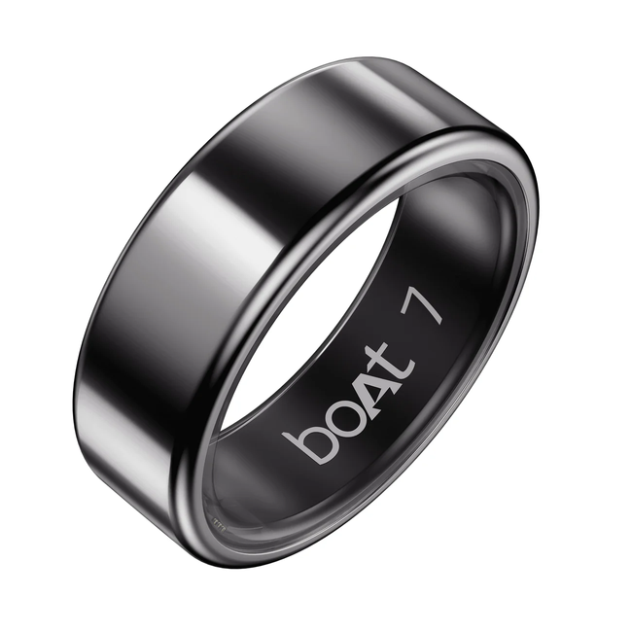
PRODUCT
PORTFOLIO

Slide 8
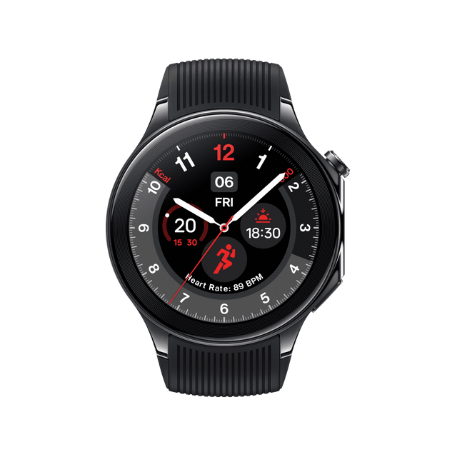
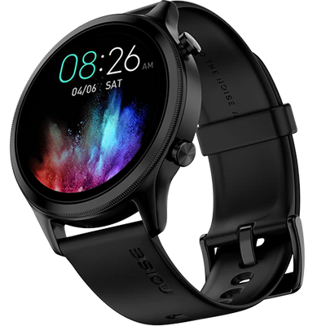
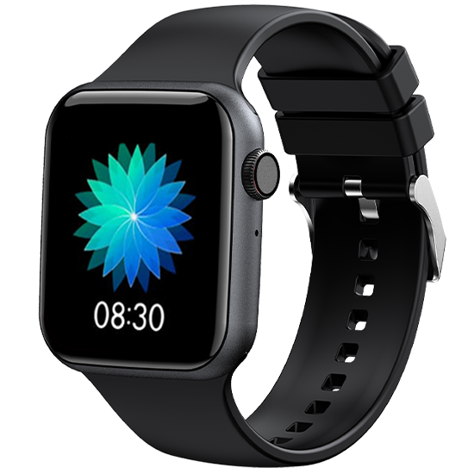
COMPETITIVE LANDSCAPE ANALYSIS
Key Competitors
Noise: Targets budget-conscious tech enthusiasts with feature-rich wearables (e.g., Noise ColorFit Pro).
OnePlus: Focuses on premium audio (e.g., OnePlus Buds Pro) with ecosystem integration for Android users.
Realme & Xiaomi: Offer high-spec, budget-friendly devices, competing on price and features.
Fire-Boltt & Fastrack: Emphasize fashion-forward wearables, targeting style-conscious youth.
Competitive Behavior
Product Launches: Competitors release frequent updates (e.g., Noise’s gaming-focused earbuds, Realme’s fitness trackers).
Influencer Marketing: Brands like Noise and Fire-Boltt collaborate with micro-influencers for niche reach.
Ecosystem Integration: OnePlus and Xiaomi build interconnected device ecosystems, enhancing user retention.

Slide 9
KEY COMPETITORS
Brand | Positioning | Unique Offer
boAt | Youthful, Lifestyle, Affordability | Stylish audio & wearables at value prices
Noise | Tech-oriented, Fitness-focused | Advanced smart features at accessible prices
Realme | Feature-driven, Value-oriented | Budget-focused high-spec devices
OnePlus | Premium, Integrated ecosystem | Seamless Android-focused audio experience

Slide 10
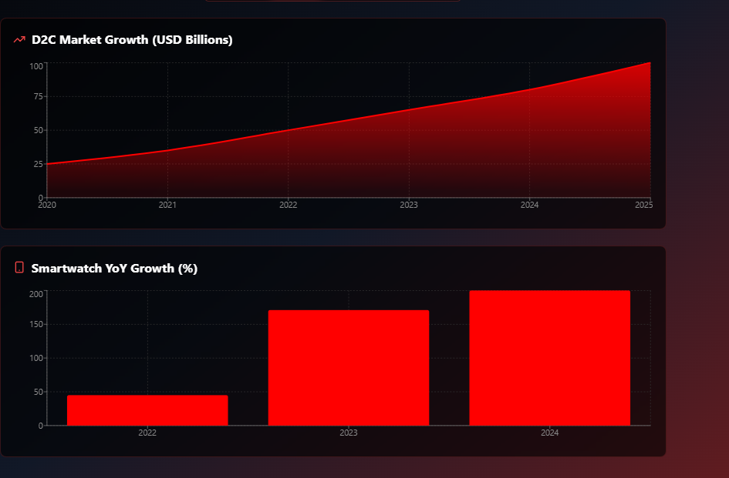
CURRENT & EMERGING TRENDS ANALYSIS
D2C Growth: D2C brands like boAt are disrupting traditional retail, with the Indian D2C market expected to reach USD 100 billion by 2025 (Inc42, 2024).
Smart Wearables Surge: Smartwatch sales grew 171% YoY in 2023, driven by budget-friendly options (IDC India, 2024).
Gen Z and Millennial Preferences: 70% of online shoppers in India are under 35, prioritizing style, affordability, and e-commerce convenience (KPMG, 2024).
Local Manufacturing: Government incentives have increased domestic production, reducing import dependency.
Personal Expression: Consumers seek tech products that reflect identity, blending fashion and functionality.

Slide 11
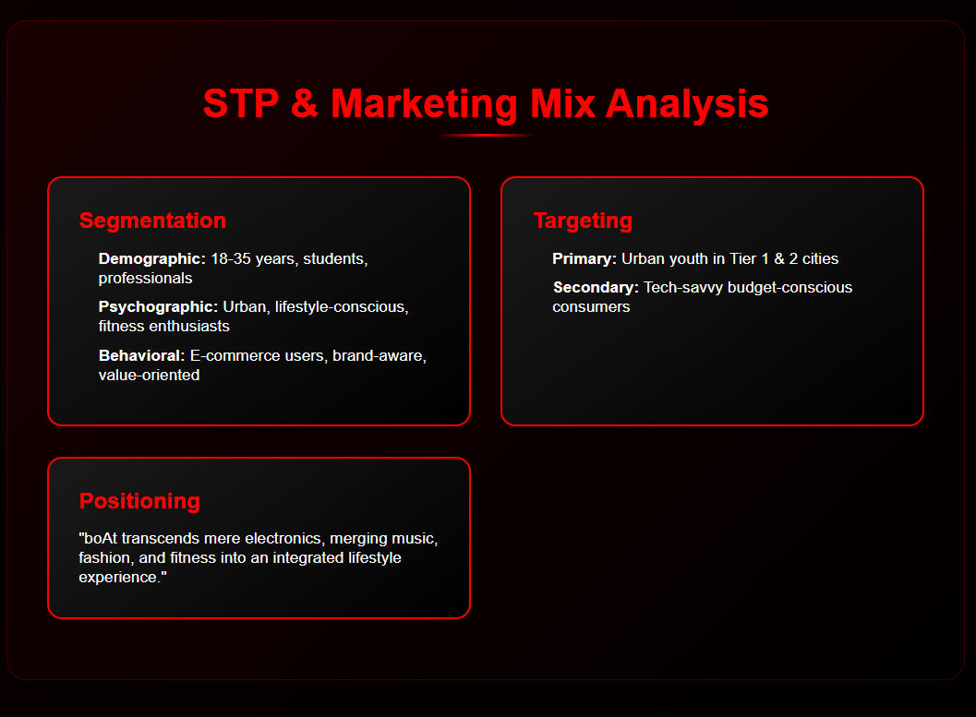

Slide 12
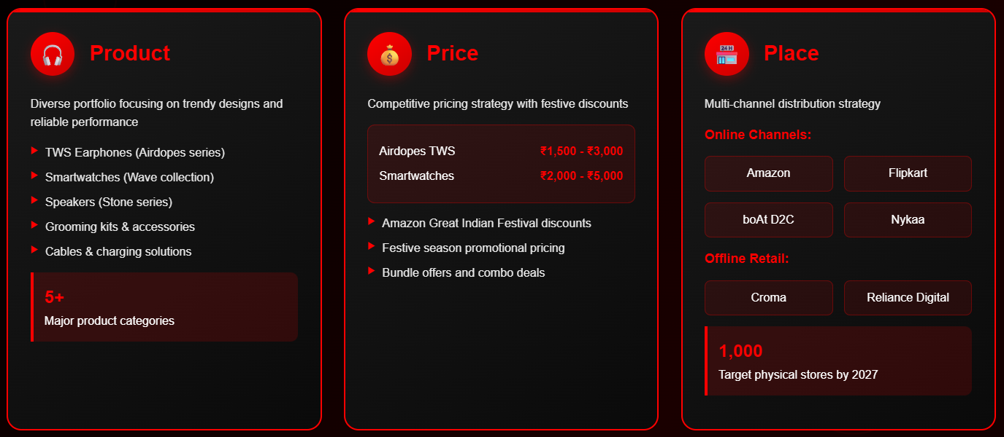
7 P’S OF MARKETING

Slide 13
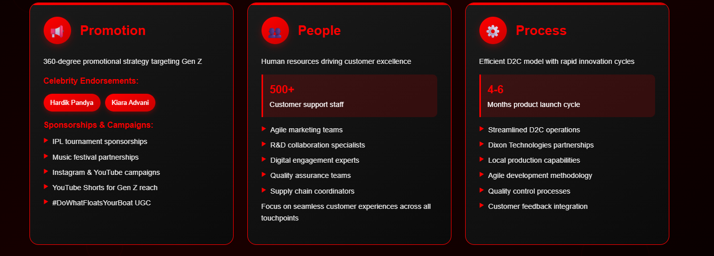
7 P’S OF MARKETING (CONT’)

Slide 14
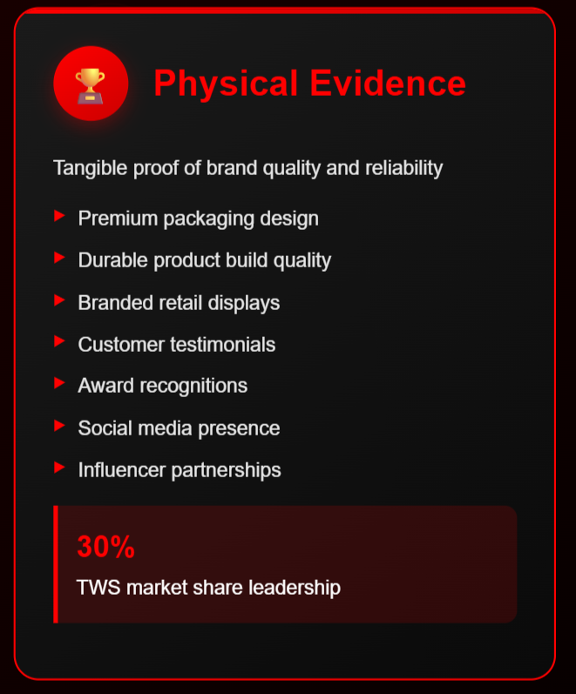
7 P’S OF MARKETING (CONT’)

Slide 15
PORTER’S FIVE FORCE
Force | Intensity | Key Factors
Threat of New Entrants | MODERATE | • Low manufacturing barriers but high brand-building costs
 |  | • Established distribution networks create some protection
 |  | • Patent protection is minimal in this industry
Threat of Substitutes | HIGH | • Multiple alternatives: wired headphones, premium brands
 |  | • Smartphone-integrated audio solutions
 |  | • Smart speakers and home audio systems
Supplier Bargaining Power | MODERATE | • Dependency on Chinese ODM manufacturers
 |  | • Multiple supplier options available
 |  | • Commodity components reduce switching costs
Buyer Bargaining Power | HIGH | • Price-sensitive Indian consumers
 |  | • Easy online comparison shopping
 |  | • Low switching costs between brands
Competitive Rivalry | VERY HIGH | • Intense competition from OnePlus, Realme, Xiaomi
 |  | • International brands like JBL, Sony
 |  | • Price-based competition is prevalent

Slide 16
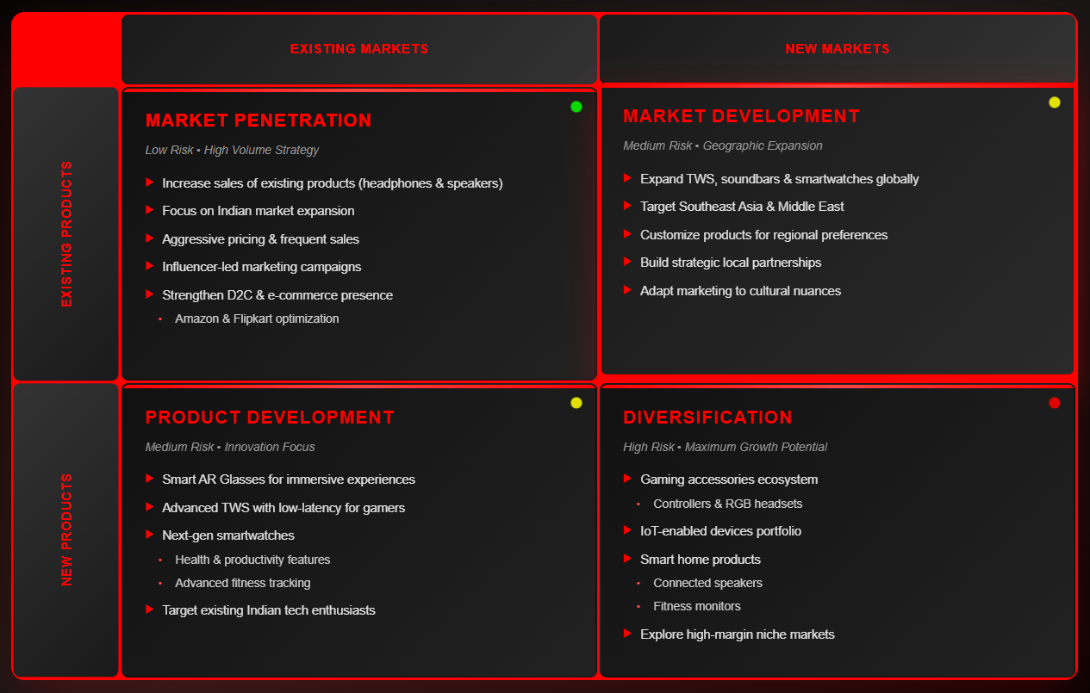
ANSOFF MATRIX

Slide 17
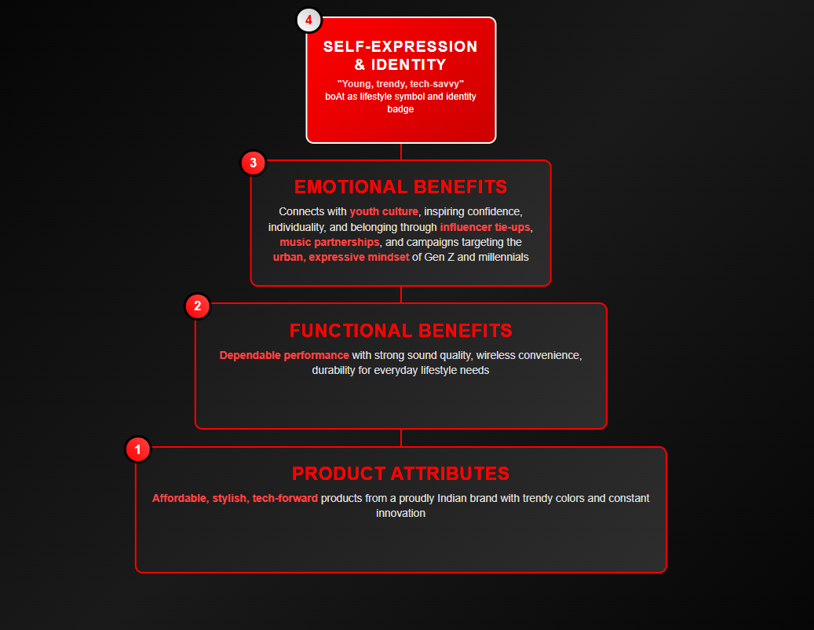
BRAND VALUE PYRAMID

Slide 18
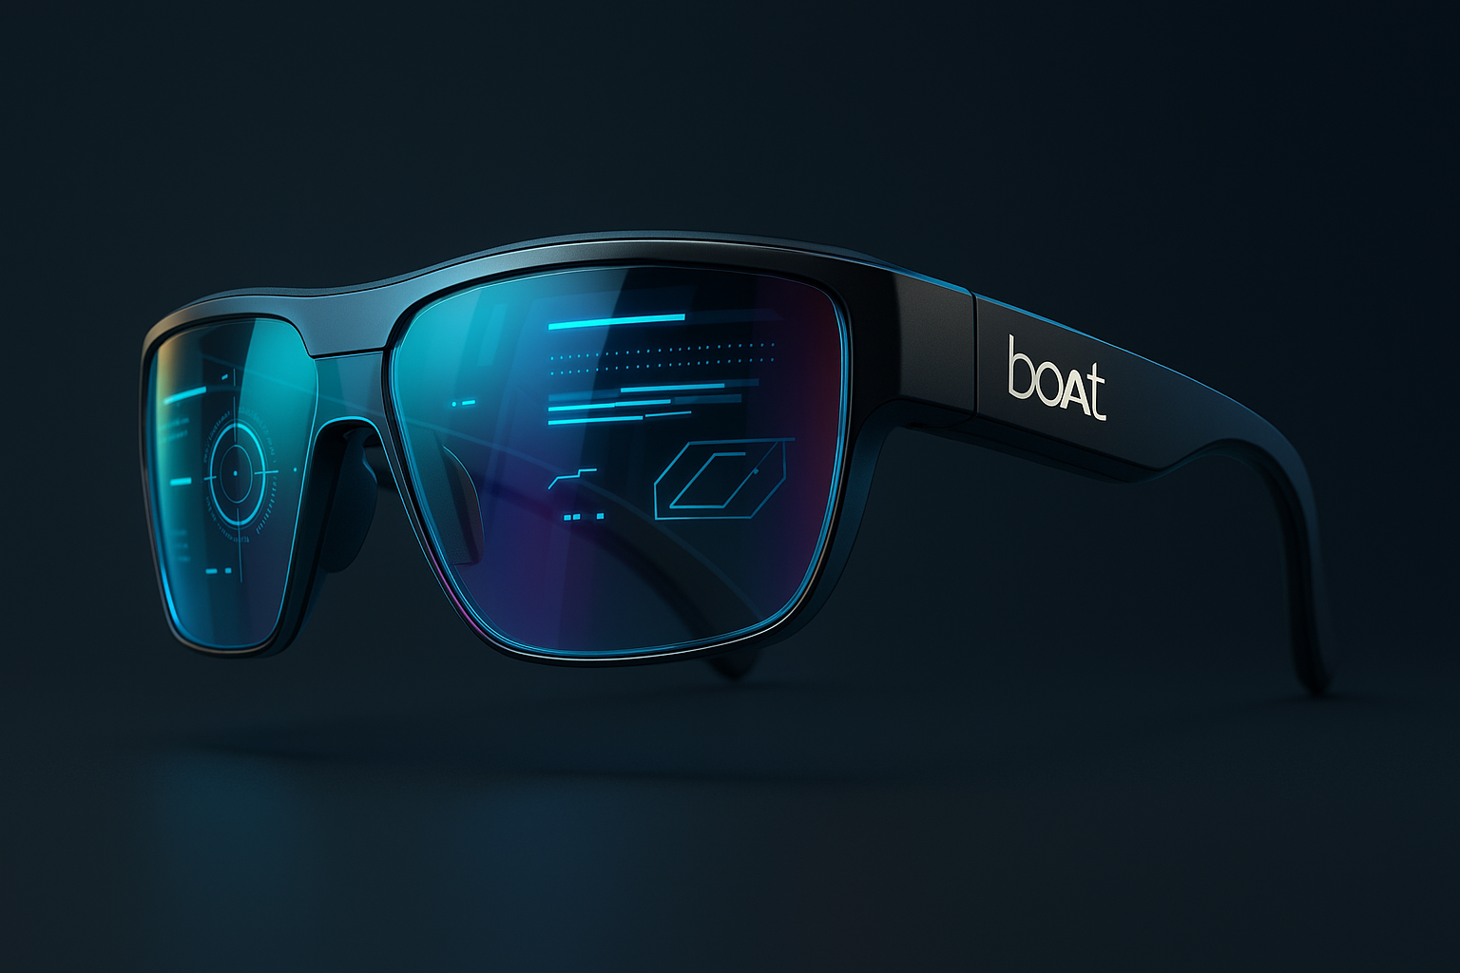
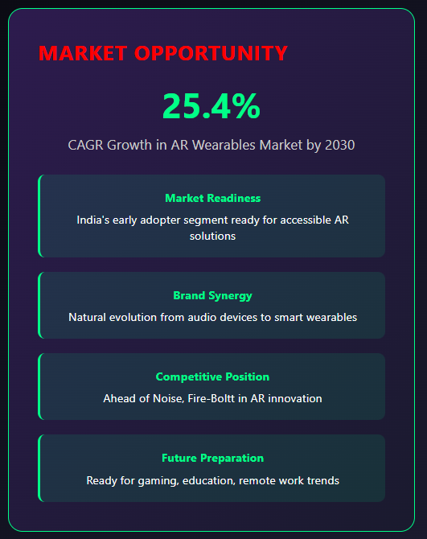
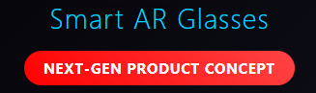
NEW PRODUCT CATEGORY SUGGESTION

Slide 19
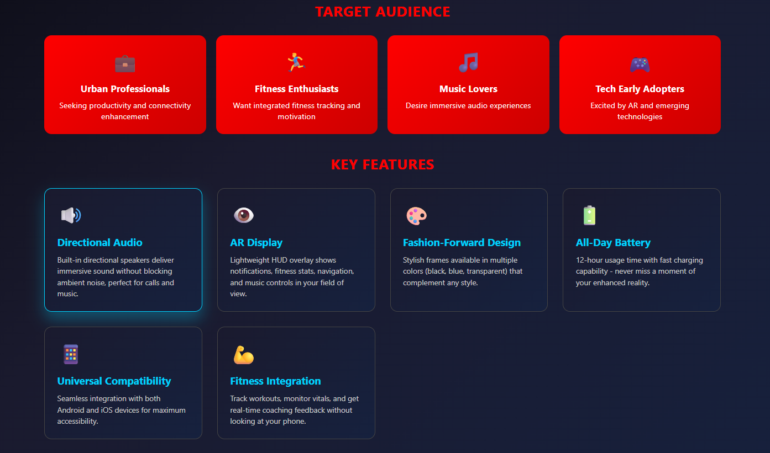

Slide 20
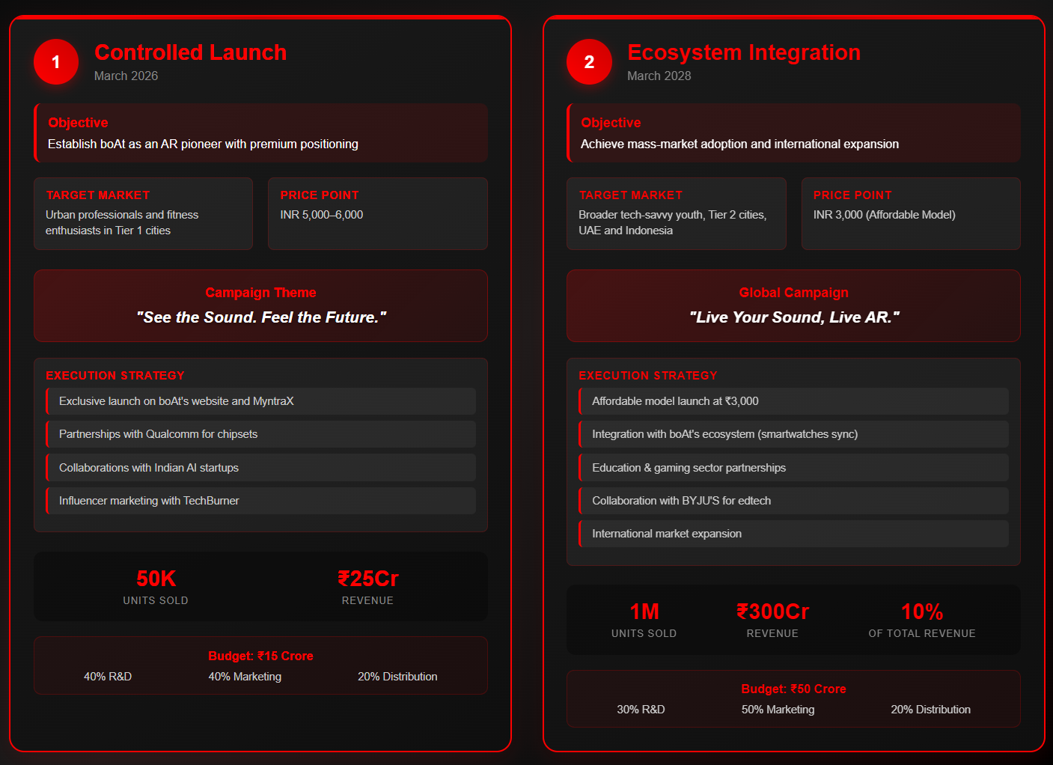
IMPLEMENTATION SCENARIOS

Slide 21
RISK ASSESSMENT
Risk | Impact | Mitigation
High R&D costs | Financial strain | Partner with tech firms (e.g., Qualcomm) to share costs.
Consumer adoption of AR | Slow market uptake | Educate consumers via demos and influencer campaigns.
Intense competition | Price wars, market share loss | Differentiate via design and ecosystem integration.
Supply chain disruptions | Delayed launches | Diversify manufacturing partners and local sourcing.
Regulatory hurdles | Compliance costs | Engage legal experts for compliance with IoT regulations.

Slide 22
CONCLUSION
boAt’s strategic marketing plan integrates its vision of youth empowerment, affordability, and innovation with India’s evolving consumer electronics landscape. By leveraging digital-first engagement, localized manufacturing, and a bold entry into Smart AR Glasses, boAt can sustain its competitive advantage and achieve sustainable growth. Continued investment in R&D, customer experience, and global expansion will cement boAt’s position as India’s leading lifestyle tech brand.

Slide 23
